Slide 1
Transmitting & Receiving Live Media Using RTP

Slide 2
Synopsis
The transmission of media takes place from one computer to another.
It also wants to broadcast a live video feed to company’s intranet.
The source of the video can be a file, live video using a video capture device or any other source.
Media can be received from the Server to which the Camera is attached and live images are captured.
Protocol used for transmission & receiving is RTP
( RTP : Realtime Transport Protocol )

Slide 3
Requirements
Software
OS Any GUI based OS.
Software JDK 1.3
API JMF 1.2.1
Database Ms Access
Hardware
CPU Pentium IV
Hard disk 10 GB
Webcam Any Webcamera

Slide 4


Existing System
TCP/IP
T
C
P
-
I
P
RTP
TCP/IP
TCP/IP

Slide 5
Limitations of Existing System
The main disadvantage of the existing system is transmissions are done by TCP/IP protocol.
There is a possible for missing a frame during the transmission .
The re-transmission occurs more time.
Since TCP/IP is connection-oriented , the transmission occurs only when the client is connected to the server.

Slide 6
Proposed System
RTP
R
T
P
RTP
RTP

Slide 7
Advantages of RTP
RTP is a connectionless protocol.
RTP provides end-to-end network transport functions suitable for applications transmitting real-time data, such as audio, video over multicast or unicast network services.
RTP does not address resource reservation.
It provides minimal control and identification functionality.
Re-transmission is not required , hence time-delay is less.
RTP is defined in Java Media Framework 1.2.1

Slide 8
JMF
The Java Media Framework API (JMF) specifies a simple, unified architecture to synchronize and control audio, video and other time-based data within Java applications and applets.

Slide 9
Modules
Transmission of Live media
Receiving of Live media

Slide 10
Transmission Module
        Authentication
        RTP Transmission
        Session Tracking
        Creating player and RTP Manager
        RTP Monitor
        Storing previous configuration

Slide 11
Authentication
User
Login
[No]
[User name & password]
Authentication
Client
[Response]
[Request]
[Yes]
Validation Processes
Data
Base
Server
Receiving System
Transmission System
Player
Application
Transmission

Slide 12
Transmission
Media Device
Frame
Capture
Broadcast
Process
[ IP Address & Port No ]
Send this for
Validation
Transmitting
User Input
Get the IP and Port address of the sender and the receiver.

Slide 13
Session Tracking
Application
Server
Authentication
Client
Receiver 1
Receive 2
Receiver 3

Slide 14
RTP Managers
RTP takes care of sending data to the specific port of the client
The datas are put in to the processor.
These are in-built in JMF.

Slide 15
RTP Monitor
RTCP packets
        Time interval
        Sender name
        Host Name
        Packet Sequence no
Format : time_inteaval from sender_name@host_name ssrc=sequence no
Example:10:2:12 from ruban@home ssrc=51063840

Slide 16
Storing Previous Configuration
When ever the system is shutdown the IP address & port no’s are stored in the system for future use.
Each system has specific home directory. The configurations are in this directory(File name:xmit.dat)
At the time of restart these configurations are retrieve from this file.

Slide 17
Receiving
Get the IP and The
Port Address of Sender and receiver
User Input
Send this for
Validation
Capture frames associated with different ports
Match
Send appropriate
Stream
User specific
Applications
User specific
Applications

Slide 18
Snap shorts

Slide 19
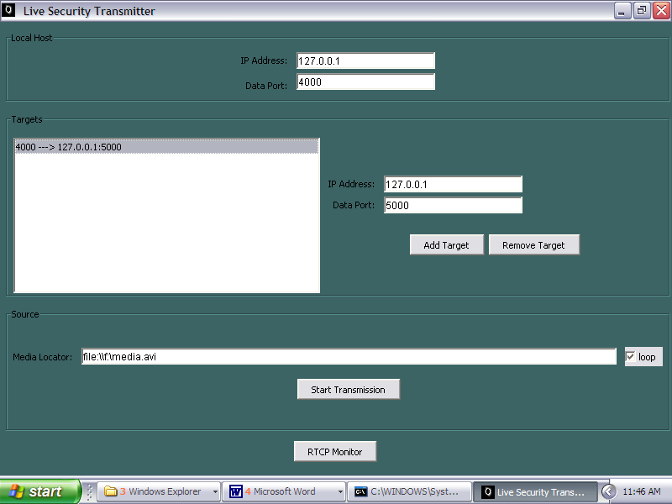
Transmission

Slide 20
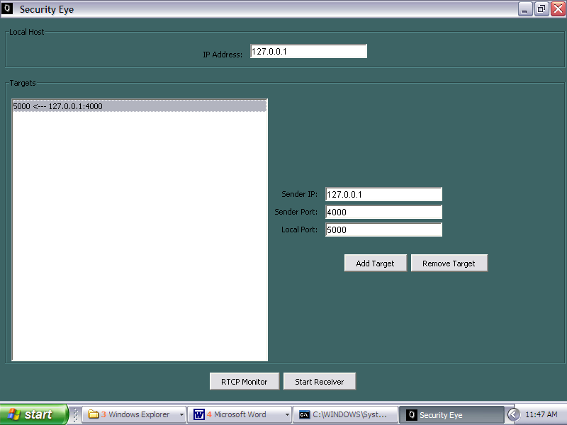
Receiving

Slide 21
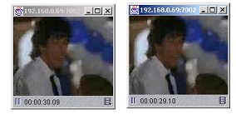
Output screen

Slide 22
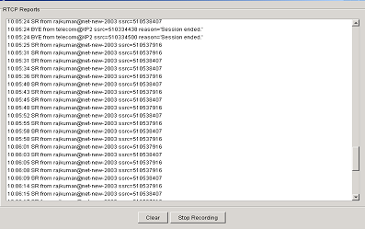
RTCP Monitor

Slide 23
Thank You

